Slide 1




Istituto Clinico Humanitas
Group 6
Christian Alfonso, Ishan Patel, Shawn Kalish, Rushiil Deshmukh, Saiteja Yerasi

Slide 2
Table of Contents
1.
2.
3.
4.
OECD & Italy Metrics
Question 1
Question 2
Conclusion

Slide 3



What is quality of care and why is it hard to measure?
Notes:
Why is quality of care hard to measure - quality of care is difficult to measure directly because it is a theoretical concept that can encompass different aspects depending on the exact definition and the context of measurement.

Slide 4
What quality metrics does Italy and the World use?

Slide 5
OECD Quality Metrics
Primary Care
Cancer Care
Hospital admission
5 year net survival rate
Acute Care
Mental Health Care
Mortality rate
Suicide rates post discharge
Patient Safety/Experience
Prescribing in Primary Care
Postoperative wound dehiscence,
Wait times
Total volume of prescriptions (antibiotics and opioids) prescribed
Notes:
OECD Indicators - OECD has about 60-70 different indicators:
Primary Care
Asthma Hospital Admission
Cancer Care
5 yr Net survival rate
Acute Care
Mortality rates
Mental Health Care
Suicide rates after discharge
Patient Safety
Postoperative wound dehiscence
Patient Experience
Prescribing in Primary Care
Total volume of prescriptions (antibiotics and opioids) prescribed

Slide 6
Italy Quality Metrics
Rate of Hospitalization
Age groups, Medical Type
Access Rate
Vaccination Coverage/Rate
Rate of Recovery
Age groups, Medical Type
Infrastructure
Distance patients travel
Indicators from the LEA grid from the Italian National Health Service
Notes:
Italy Indicators - super regionalized system where the national government just gives a list of what each hospital should provide to its patients - based off LEA system by the National Health Agency of Italy - 20 to 21 different indicators
Italy’s National Health Service is regionally based, with the central government sharing responsibility for health care with the country’s 19 regions and two autonomous provinces. At the national level, the government exercises a stewardship role, controls and distributes the tax-financed health budget, and defines the national benefits package (known as the ‘Essential Levels of Care’) that must be guaranteed to all citizens and foreign residents. Regions are responsible for the organization, planning and delivery of health services through local health authorities. Public hospital-based physicians are salaried employees
Rate of hospitalization
Age groups
Medical types
Rate of recovery
Age groups
Medical types
Access rate to medical types
Vaccination coverage
Infrastructure
Ease of access

Slide 7
Question: What are ICH Quality Metrics?
01
Notes:
Shawn:
Thank you, Ishan…
So now that we’ve briefly covered what typical quality metrics are, we’d like to talk about ICH and how they were able to separate themselves from the pack by keeping quality and efficiency in mind from the ground up…

Slide 8


-Built for Efficiency
-Staff Quality
-Patient Feedback
-ALOS Reduction
Notes:
Shawn:
Now that we’ve briefly covered what typical quality metrics are, we’d like to talk about ICH and how they were able to separate themselves from the pack by keeping quality and efficiency in mind from the ground up. Before construction even began, decisions were being made that would benefit everyone involved, including the patients. The building site in Rozzano was chosen because town planning approval would be faster and easier, and that area needed major health-care service improvement.
Built for Efficiency:
When ICH was built, “operational efficiency was the foremost consideration” and the layout alone lent itself to better quality of care.
1. Within hospital travel distance was minimized for patients and nurses, increasing time available for patient care.
2. The style and materials used for construction maximized sunlight, created a comfortable environment, and maintained flexibility for future upgrades.
3. And there were plenty of amenities put into place for staff, generating a more desirable working environment.
Staff Quality:
Staff quality was also very important for ICH to align with their goals.
1. The high performance-based pay and latest technology attracted the country’s top physicians.
2. Nurses were also top-notch, inherently needing to be given the multispecialty wards and job complexity.
3. Additionally, high job satisfaction made for happier staff and less turnover, ultimately strengthening continuity of care.
ALOS Reduction:
ICH intended on reducing average length of stay as well by specially developing new protocols and innovations.
1. The dedicated day surgery team and unit was unlike other hospitals, and
2. The clinical service departments were organized to maximize productivity as they would take on double the operations of neighboring hospitals.
Patient Feedback:
Finally, an ongoing feedback system would be implemented at ICH so that patient concerns could be heard and addressed.
1. Patients were asked to fill out “scorecards” for inpatient, outpatient, and day surgery procedures.
Now our colleague Rushiil will report on the success of these metrics…

Slide 9
Question: How well is ICH doing
on quality?
02

Slide 10
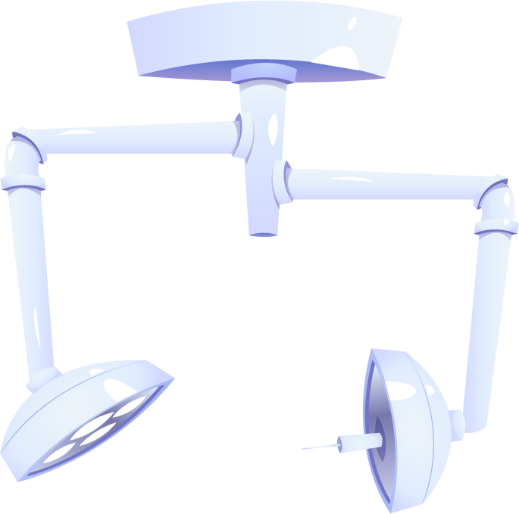

ICH ranking
#4 Best Hospital
Rated by patients
ICH was ranked as the 4th best hospital in Italy in a 2022 Statistical survey
Patient survey included various metrics

Slide 11
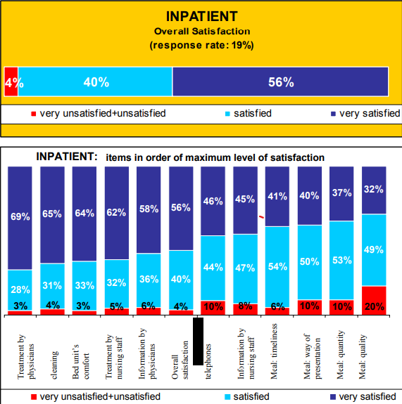
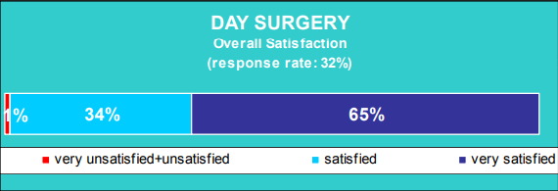
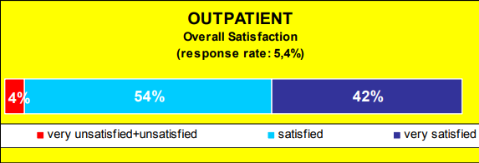
ICH Satisfaction Survey
Notes:
Humanitas also monitored patient satisfaction every month. Patients were asked to complete questionnaires, which were given every day to inpatients and five days per month to outpatients. In 2001, the response rate in the wards was 19% (up from 9% in 2000) and in the outpatient departments 5.4% (up from 2.1% in 2000)
ICH seems to be performing well on its metrics, with average satisfaction higher than 50% for inpatient and outpatient patients. This number appears to lower itself for outpatient practice. This could also be because response rates across the board are lower than 50%, going as low as 5 % for outpatient clinics. This may ot truly representative of the population and this does not provide a strong indicator of general/overall satisfaction.

Slide 12
Conclusion
1. ICH quality metrics
i. Daily occupancy reports
ii. Utilization reports covering patient volume, revenue and costs
iii. Tracking patient satisfaction
2. ICH performance on quality metrics
i. Occupancy rate in July 2001 was 82%
ii. Net profit in 2001 was €11.8million
iii. InPatient and OutPatient surveys had an overall satisfaction rate¹ of 96%
iv.Day surgery survey had an overall satisfaction rate¹ of 99%
1. Considering satisfied and very satisfied as the criteria for satisfaction

Slide 13

Thank you!
Questions?
Comments?

